Slide 1
Flutter
Presentation By Ali Asnaashari

Slide 2
TABLE OF CONTENTS
01
02
03
04
Introduction
Flutter Vs ReactNative
Dart Language
Get Start

Slide 3
01
Introduction

Slide 4

Flutter.dev
Short History
Mobile Ui Framework
Software Development Kit | SDK
OpenSource (https://github.com/flutter/flutter)
Flutter Logo

Slide 5

Construction and Idea
Eric Seidel
Achieve more speed
Rendering Engine
Startup failed

Slide 6
MISSION STATEMENT
Fast Development
Expressive and Flexible UI
Native Performance

Slide 7
Flutter Weak Points
Large application file size
Lack of libraries
Some flutter problems with iOS
Dart problems in the flutter

Slide 8
02
Flutter Vs Reactnative

Slide 9
Flutter VS ReactNative
Google
Facebook
2017
2015
DART
Javascript - React
OpenSource
OpenSource
Growing Community
Huge Community
Comprehensive Ui Widgets
Minimal Ui Widgets

Slide 10
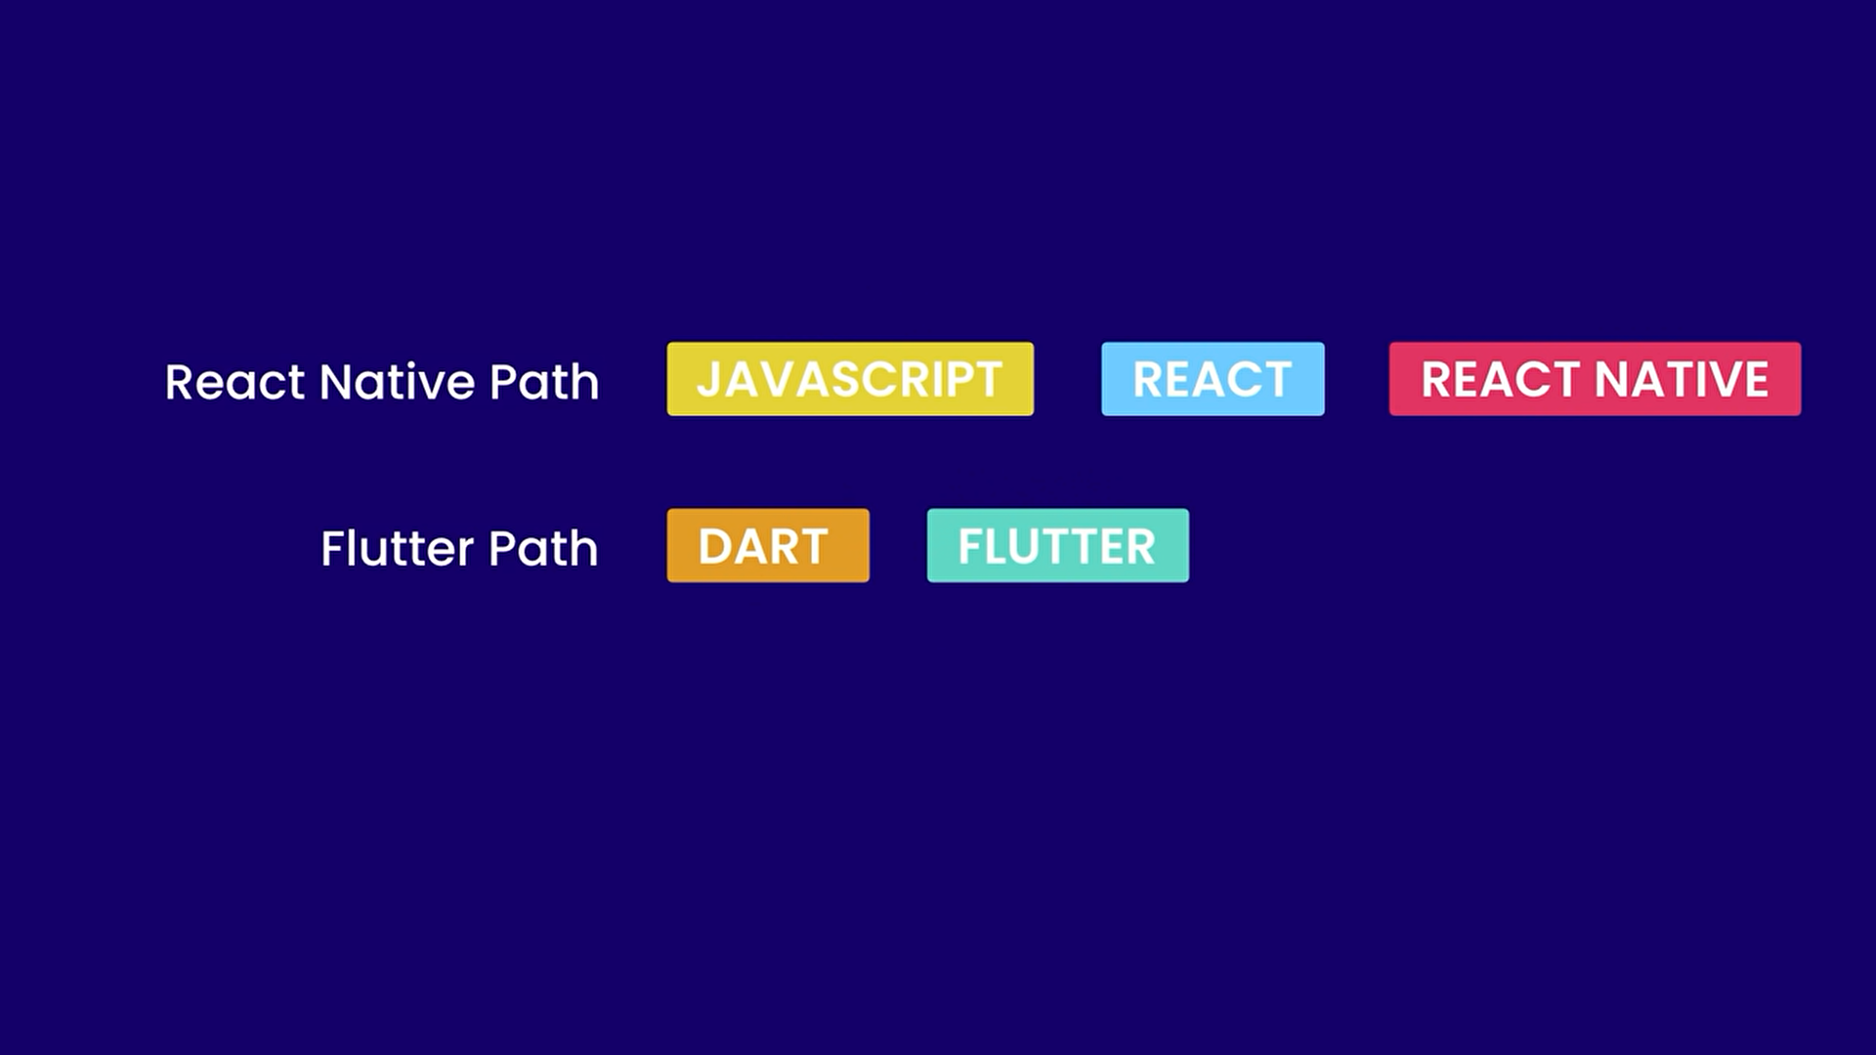
Learning Path

Slide 11
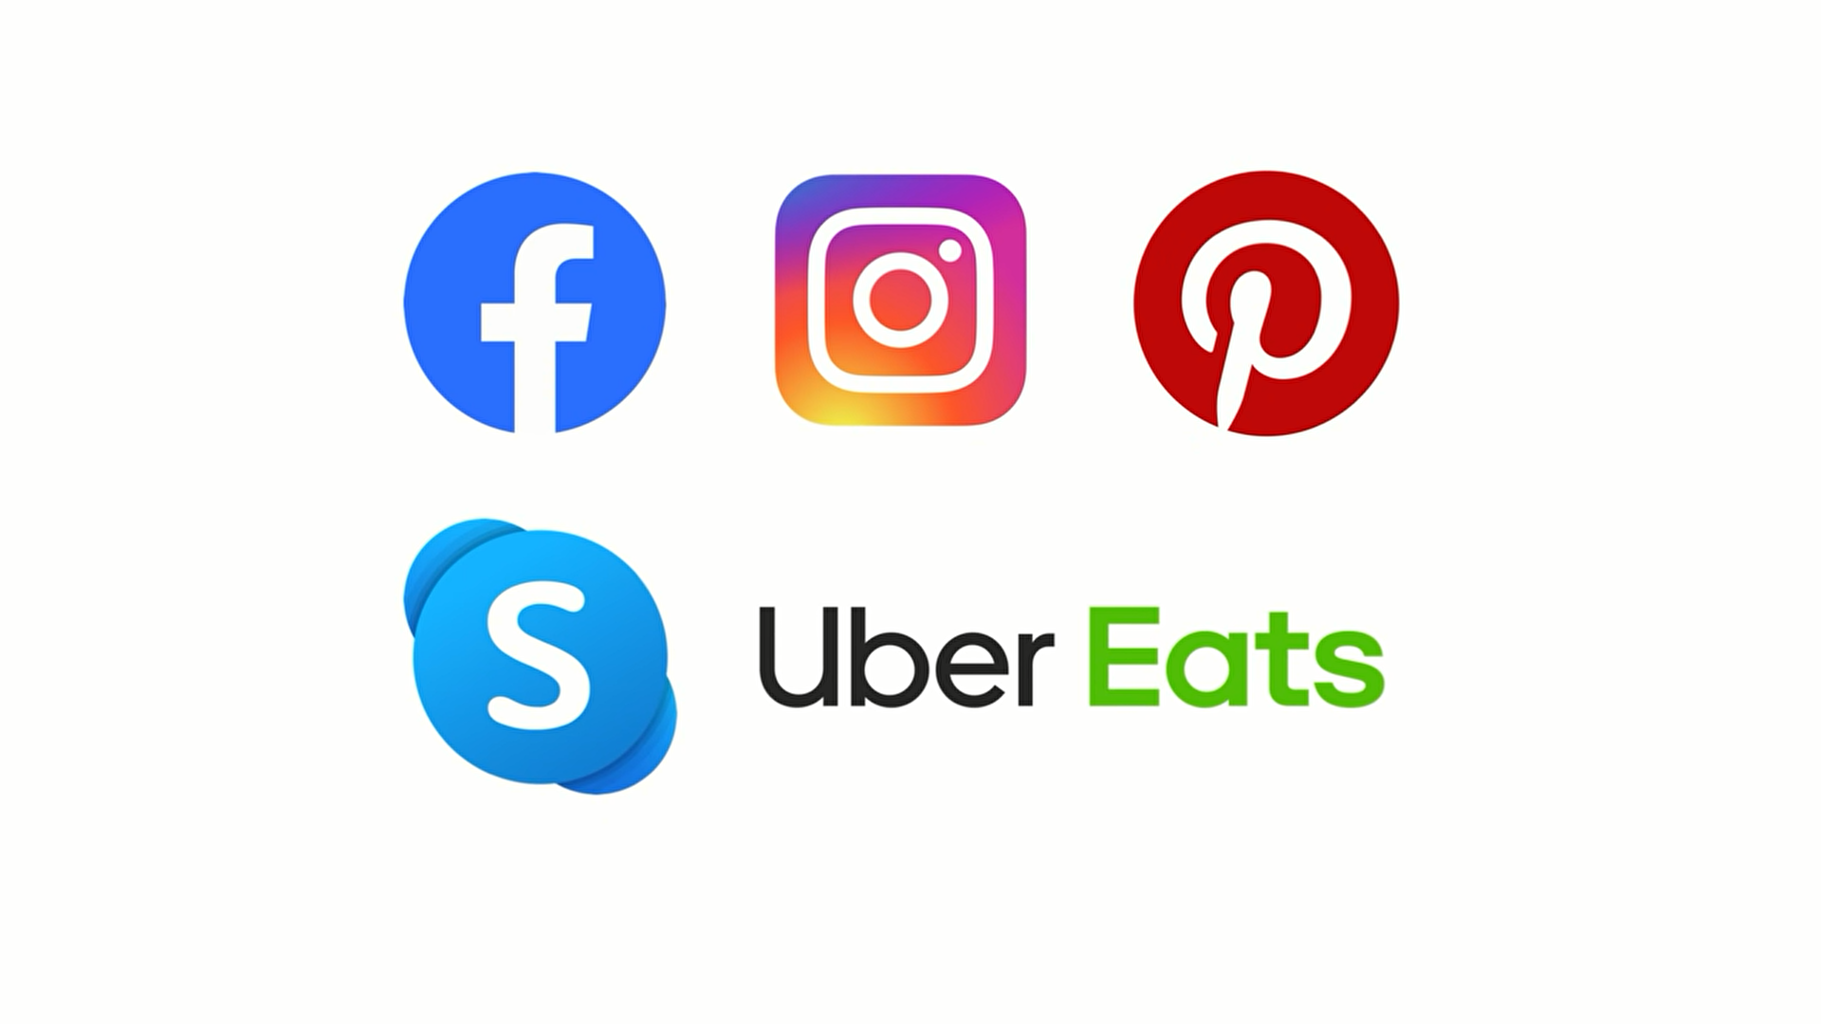
APPS BUILT BY REACTNATIVE

Slide 12

APPS BUILT BY Flutter

Slide 13
03
Dart Language

Slide 14

dart.dev
Short History
Optimized for UI
Productive development
Fast on all platforms
Dart Logo

Slide 15
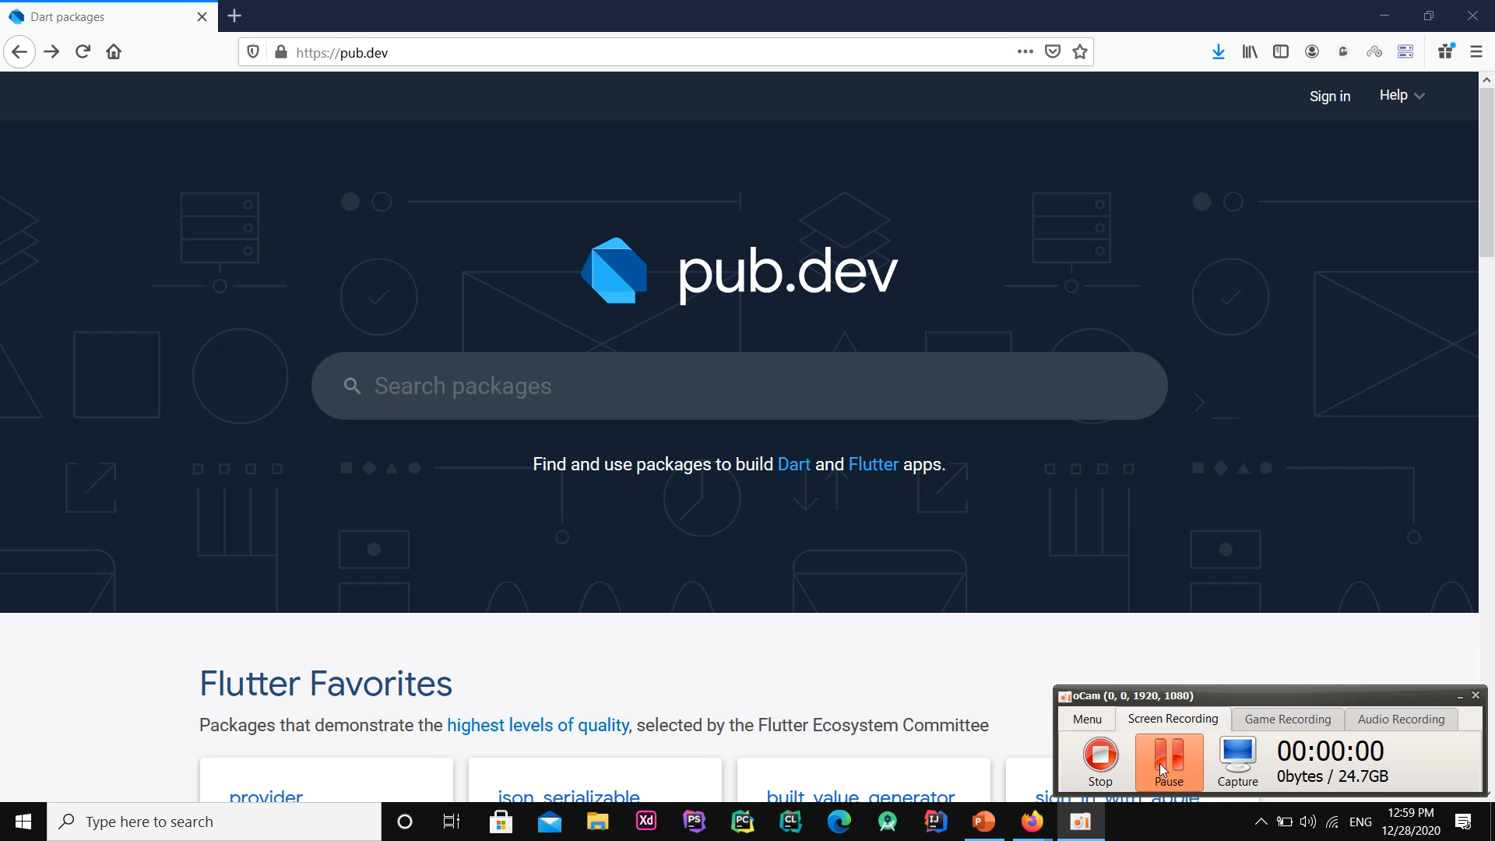
Dart Package & install

Slide 16
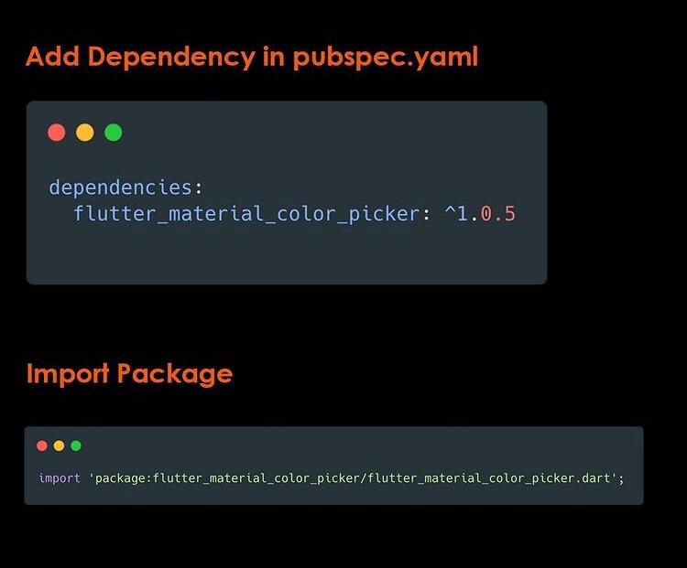
Add dependency to project

Slide 17

“Dart is a client-optimized language for fast apps on any platform “

Slide 18
04
Get Start

Slide 19
Install the flutter in Windows
Run & Create an application
Widget

Slide 20
Install Flutter
1.System requirements
2.Get the Flutter SDK
3.Update your path
4.Run Flutter doctor

Slide 21
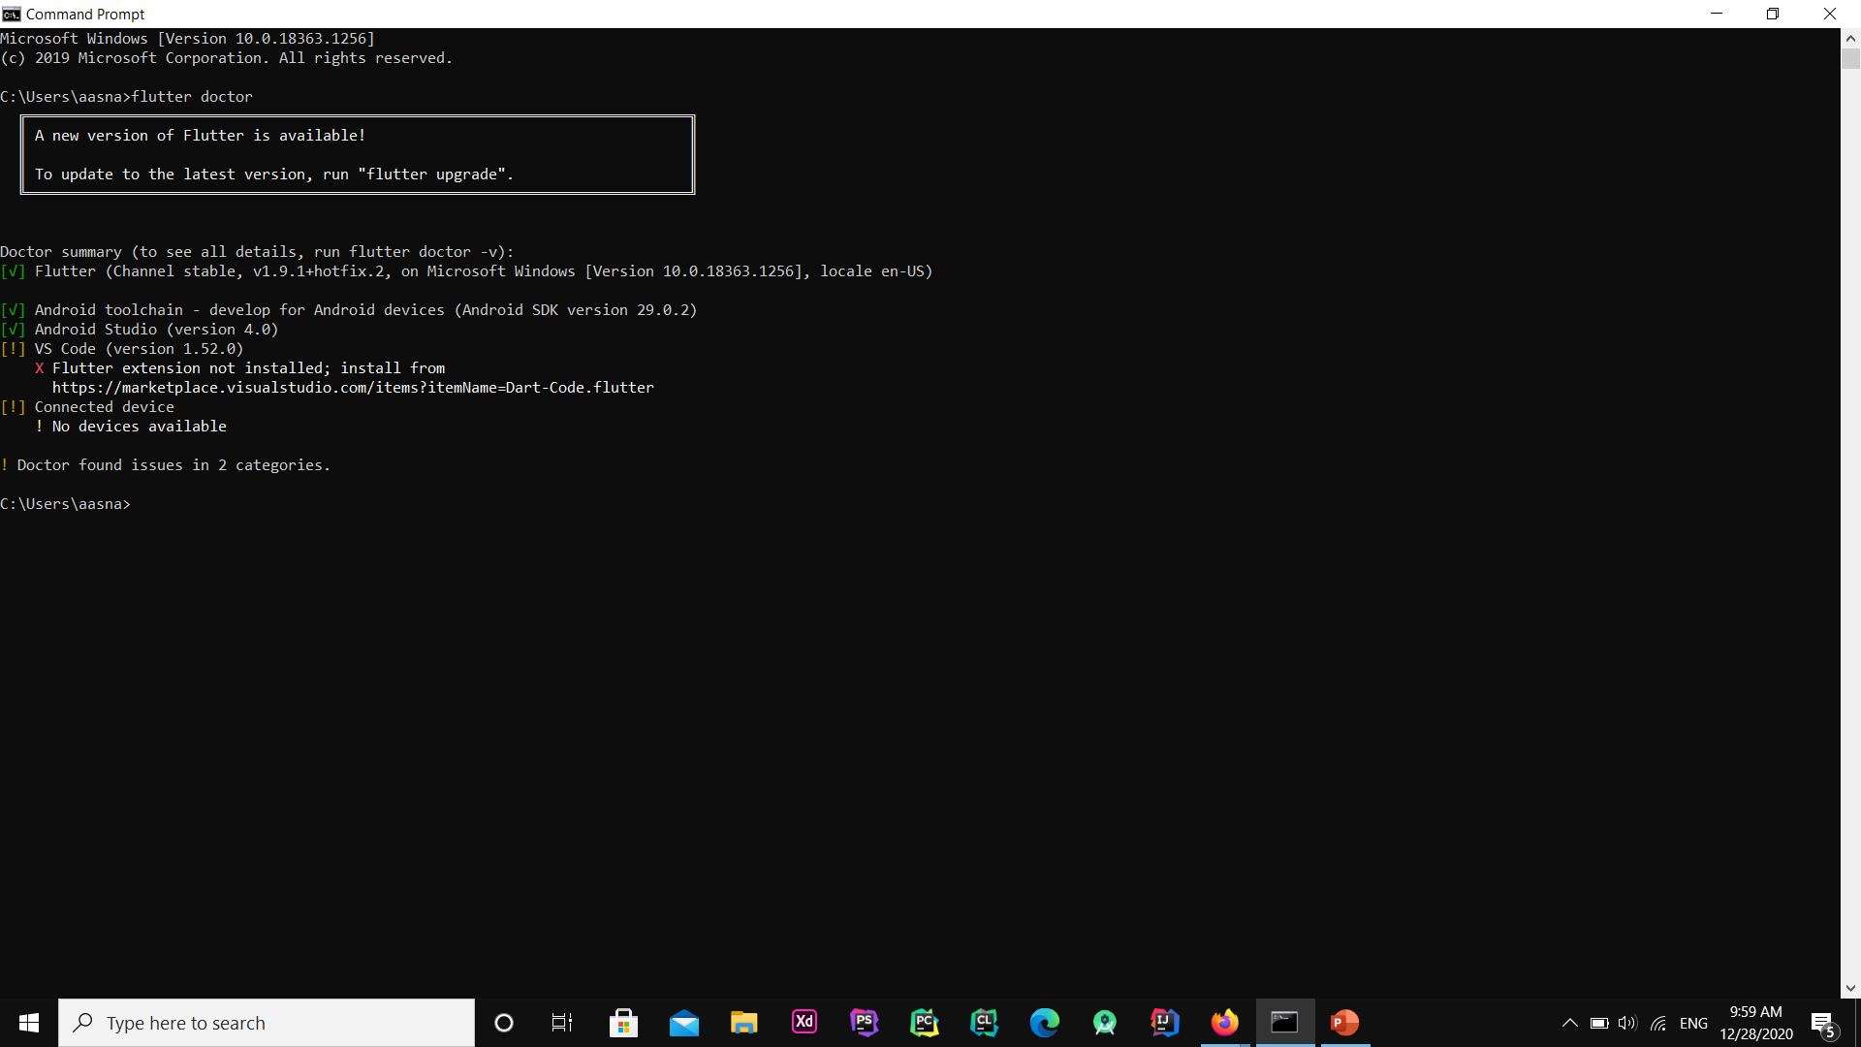
Flutter doctor

Slide 22
Create an application
Install SDK…
Demo App
Start a new
Flutter project
Flutter Application
Choose Project Name

Slide 23
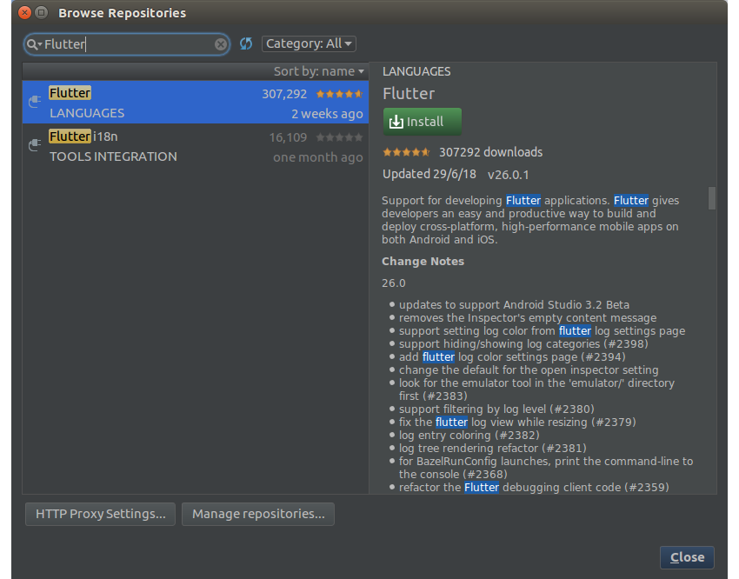
Create & Run Application

Slide 24
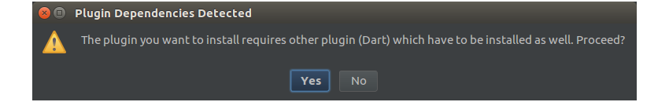
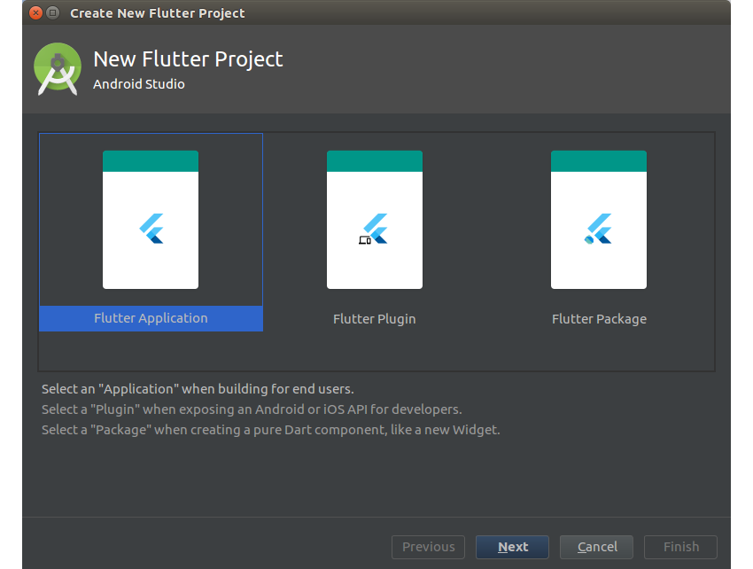
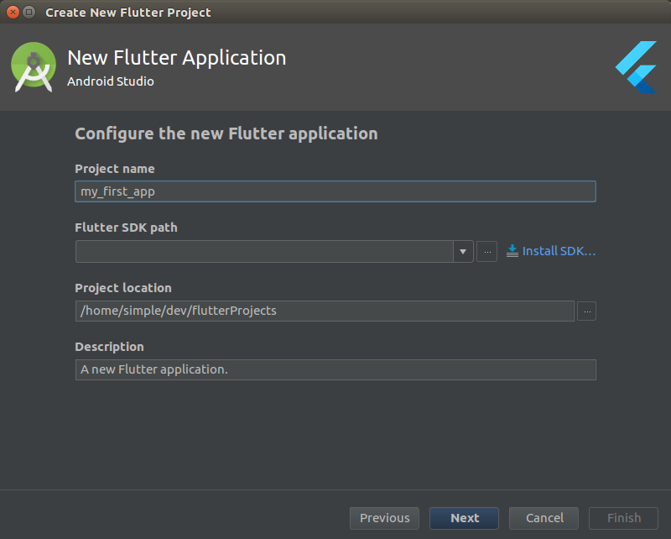
Create & Run Application

Slide 25
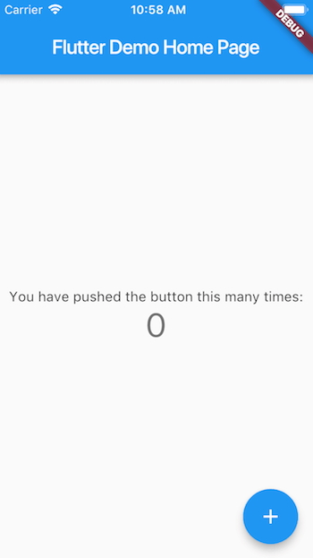
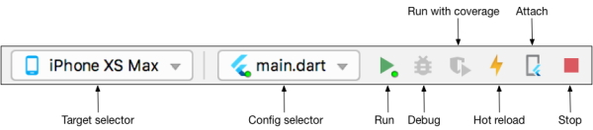
Run Application
Stateful Hot Reload
This feature allows you to reload the code of a running application, without the need to restart or lose the status of the application.

Slide 26
Widget
The core of the flutter is widgets
Featuers
Platform specific
State maintenance
Layout widgets

Slide 27
Platform Specific
ANDROID
IOS
Material (Material widget )
Cupertino
Scaffold
BottomNavigationBar
PopupMenuButton
Date & Time Pickers
PopupMenuButton
CupertinoButton
CupertinoDialogAction
CupertinoTimerPicker
CupertinoPageScaffold
CupertinoSlider

Slide 28
Layout widgets
Container
Mercury is the closest planet to the Sun and the smallest one
Center
It is the ringed planet. It is composed of hydrogen and helium
Row
Jupiter is a gas giant and the biggest object in the Solar System
Stack
Despite being red, Mars is actually a very cold place

Slide 29
Platform independent / basic
Text
style property - TextStyle
Image
Image - Image.asset - Image.file
Image.memory - Image.Network
Icon

Slide 30
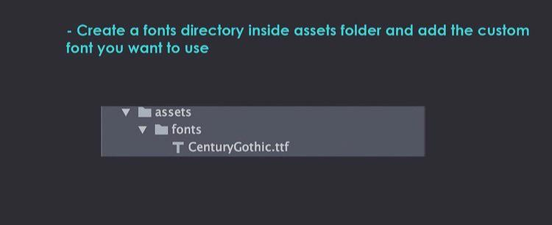
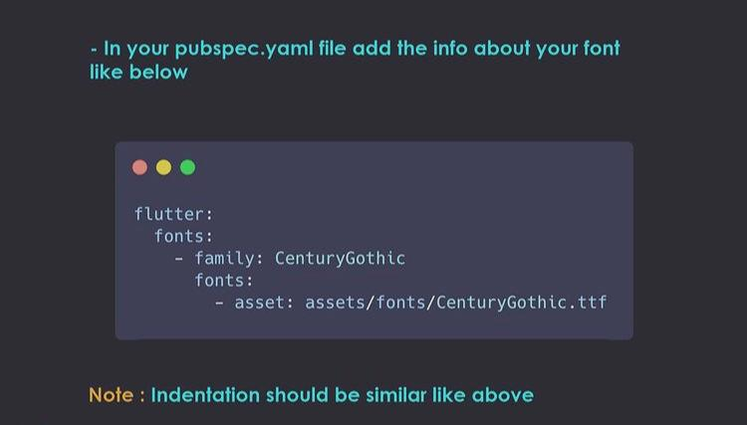
How To Use Custom Font In Flutter
State 1
State 2

Slide 31
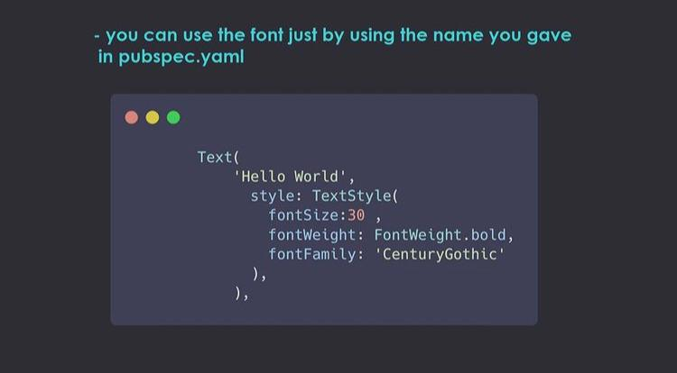
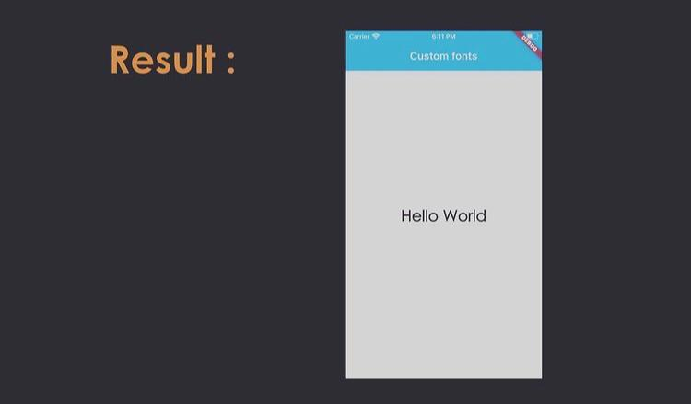
State 3

Slide 32
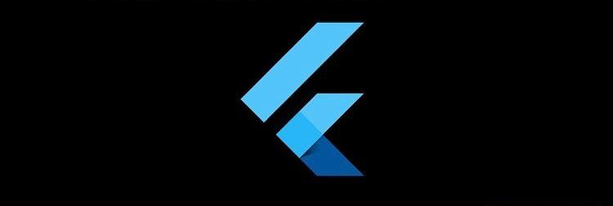
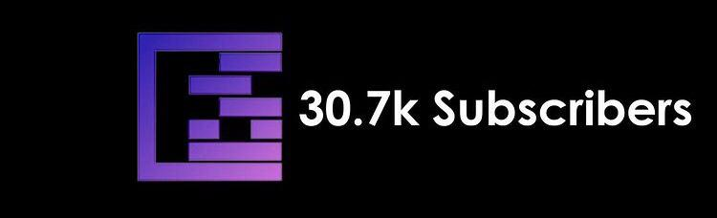
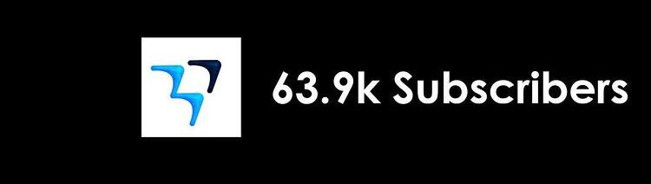
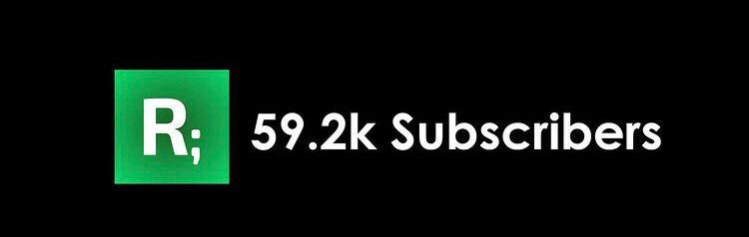
Some Best YOUTUBE Channel To Learn Flutter
FilledStacks
Official Flutter Channel
MTECHVIRAL
Reso Coder

Slide 33
THANKS

